Slide 1

Comparative Analysis of the Ragnar Locker Ransomware
Degree Digital Forensics
Notes:
Good afternoon,
My name is Marthe, and for my final degree project, I have analysed two strains of the Ragnar locker ransomware.

Slide 2

Aims and Objectives
▪ Analyse two strains of Ragnar Locker using the Hybridised Malware Framework (Schmitt, 2019).
▪ Compare the findings from the analysis of the two strains.
▪ Map the discovered TTPs in the MITRE ATT&CK framework.
▪ Provide a YARA rule that will detect both strains.
▪ Create a list of Indicators of Compromise for the strains.
▪ Contribute the discovered IOCs and YARA rule to the MISP Galaxy.
Notes:
My project is a comparative study, so the findings from the two strains are correlated and mapped.
By distinguishing the changes and the elements that remain constant, researchers are better equipped to understand the development of the family and defend against it.
The first strain I analysed was from January 2020, and is one of the first Ragnar Locker strains found “in the wild”
The second was from November 2020. During the time between the two strains, the threat actors behind the ransomware
Had manage to make a name for themselves – joining the maze cartel and taking down several industry conglomerates.
The thesis is that the discovered characteristics are likely to apply to other members of the Ragnar Locker family.
Despite the strains being tailor-made for their victims, most of the code is expected to be reused.

Slide 3
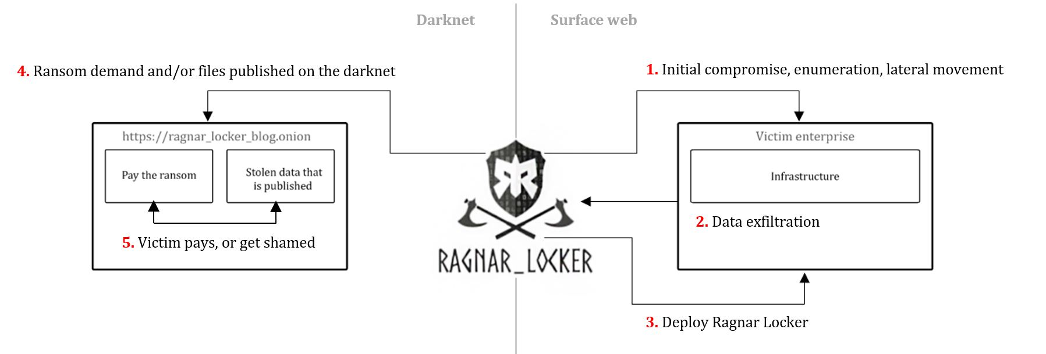
Novel Approaches to Cybercrime
Notes:
Ragnar Locker is one of the top cybercriminal groups rampaging through enterprise networks the past year.
They are also highly innovative; for instance, they pioneered an evasion technique where they deploy an old virtual machine on the victim network and then launch the ransomware from within it.
They commonly use RDP exploits to gain initial access but have been seen exploiting VPN vulnerabilities and using phishing as well.
Once inside the network, they will "live off the land" and use native tools such as PowerShell as much as possible. They also use mimikatz to dump credentials. Once they have mapped the network and extracted data, they initiate the ransomware.
If the victim decides not to pay the ransom demand, Ragnar Locker will leak their data on their Data Leak Site, the "Wall of Shame" in bulks. The data is often sensitive, and non-disclosure agreements, business secrets, and personally identifiable information is common to see.

Slide 4
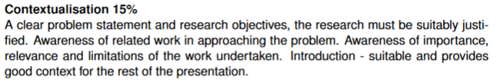
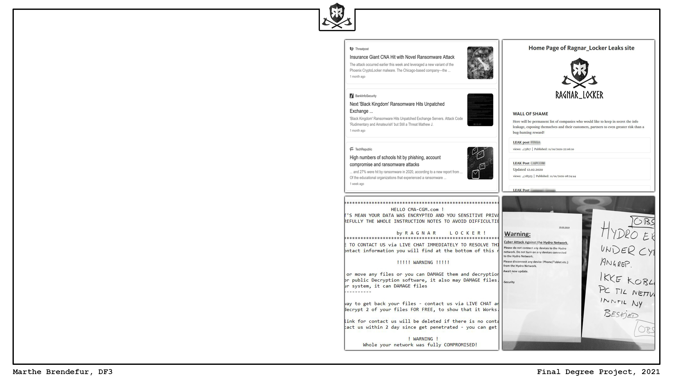
Overview of Background Research
▪ What is ransomware?
▪ Threat and impact
▪ Academic work
Notes:
Simply put, ransomware is malicious software that encrypts files and resources.
The ransomware families that are prominent in today's threat landscape is so-called human-operated ransomware strains.
This means that hackers are hands-on keyboard for large parts of the attack.
They conduct targeted attacks, aiming at organisations with high turnovers. This practice is dubbed big game hunting.
Ransomware is a billion-dollar industry and one of the most significant threats to businesses worldwide.
Despite this, little academic work has been published on the topic, not to mention the narrower field of ransomware analysis.
Most contemporary academic work focus on prevention and detection mechanisms.
Although many of the explored solutions are interesting, they are cumbersome to implement on a large scale.
They would only serve their purpose if implemented along with a variety of other security solutions.
Some academic papers focus on highly specific aspects of analysis, but they are not sufficient enough to use as is.
The only recent paper discussing a holistic approach to malware analysis is that of Veronica Schmitt published in 2019.
It suggests a framework for analysing malware in a forensically sound manner.

Slide 5
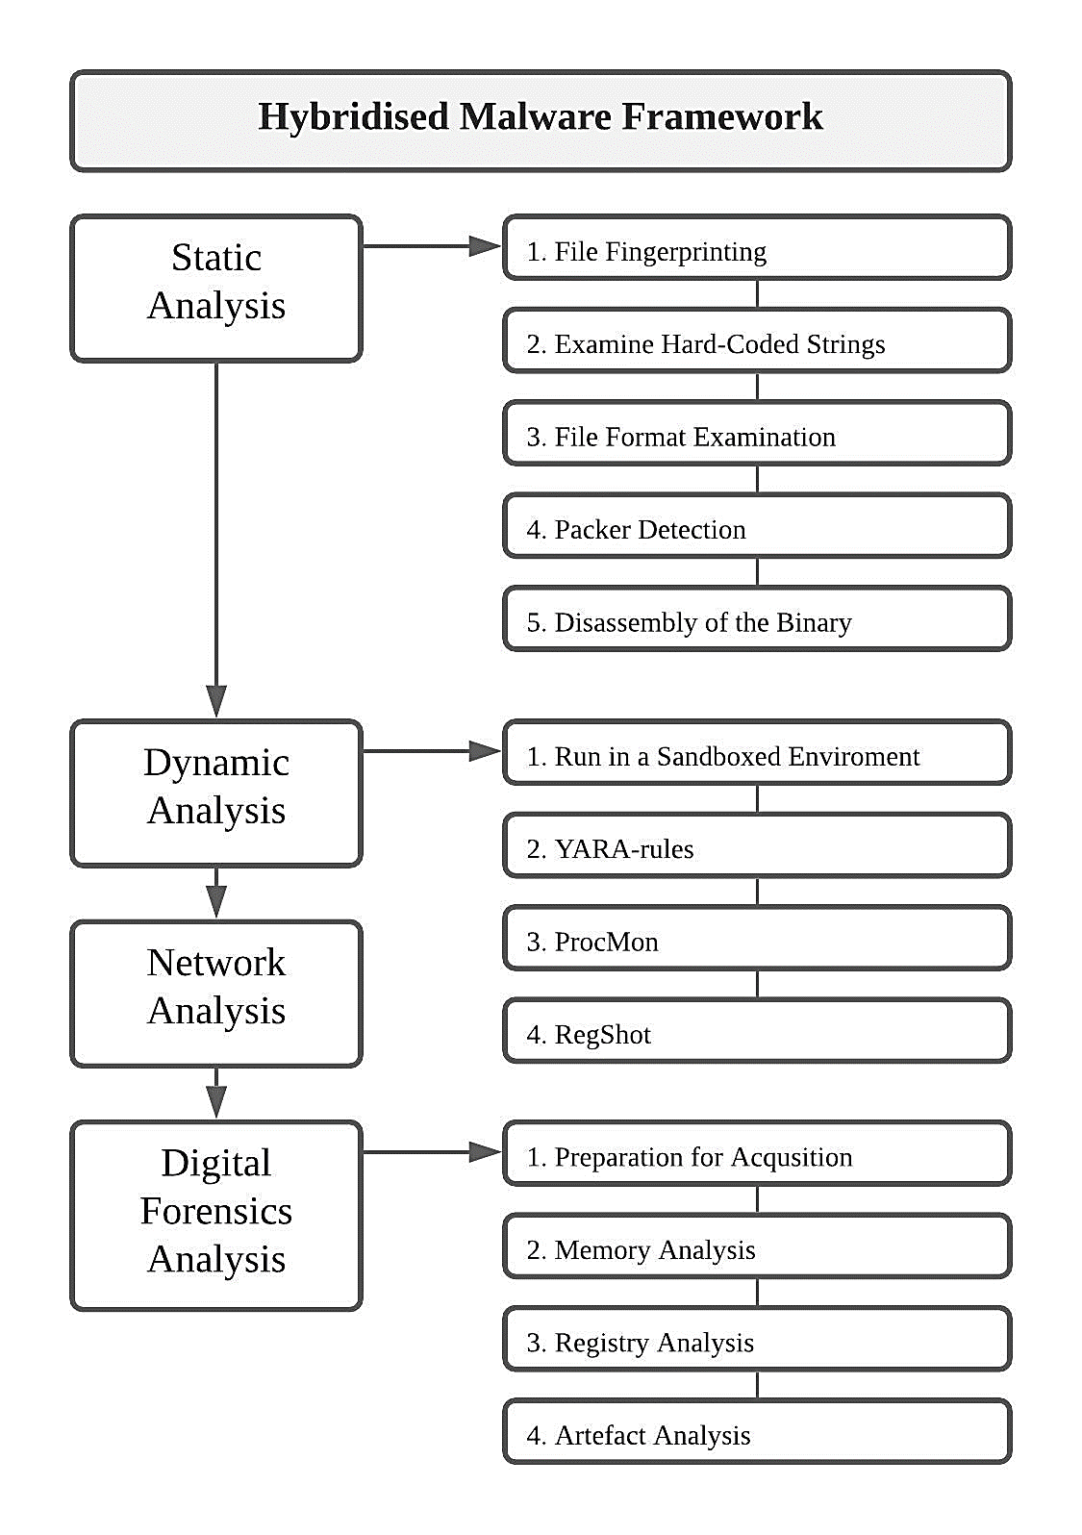

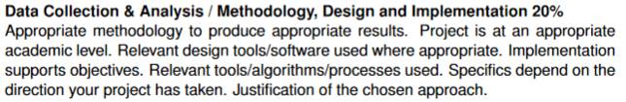
Analysis Methodology
Sandbox
REMnux
Windows 10
Notes:
The analysis of the strains followed the process detailed in the Hybridised Malware Framework developed by Schmitt.
It starts with assessing the static properties of The ransomware, such as the portable executable file header and the code at the assembly level.
Then the ransomware is executed in a Sandboxed system to see how it interacts with it and recreate eventual artefacts.
The subsequent steps depend on this execution; The system is closely monitored for signs that the ransomware calls home over the internet.
Also, the forensic analysis of the host depends on the ransomware actually being executed on it.
The sandbox setup used was solid and straightforward. The primary host was a Windows 10 machine; this is the machine that ran the ransomware.
On the same closed network, I had a Linux REMnux machine. The job of this computer was to generate internet services and capture analysis data.

Slide 6
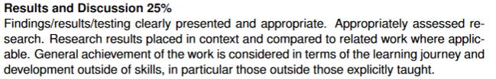
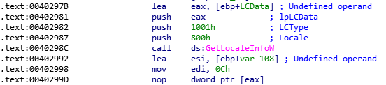
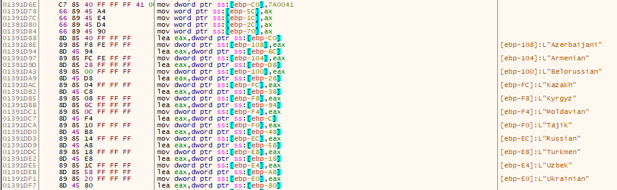
Key Result 1
Notes:
With a comparison of the two strains as a key objective in mind, the following findings are worth noting:
Both strains contain a function to check for the operating system language, as you can see in the top picture.
This is part of a kill switch; if the host language matches one of the parameters seen in the bottom photo, the ransomware will stop its execution.
In strain 1, the data in picture two is called. However, in strain 2, no data is provided in the strain.
This could either be a bug, or the developers found the function unnecessary as all the attacks are targeted.

Slide 7
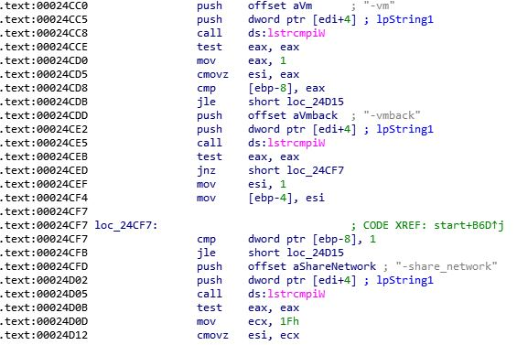
Key Result 2
Notes:
Strain 2 have a segment of code that is not found in strain 1.
The -vm, -vmback, and -share_network are command-line options used by the ransomware executable when it is deployed from a virtual machine.
They correspond to the commands in a batch file and are the commands used to initiate the payload.
The presence of this functionality indicates that the technique of using an Oracle VirtualBox hypervisor to deploy the ransomware and bypass security mechanisms was used in the attack where the second strain was deployed.
This difference between the strains is logical, as the virtual machine technique was first seen in “the wild”
In May, five months after strain 1 was used.

Slide 8
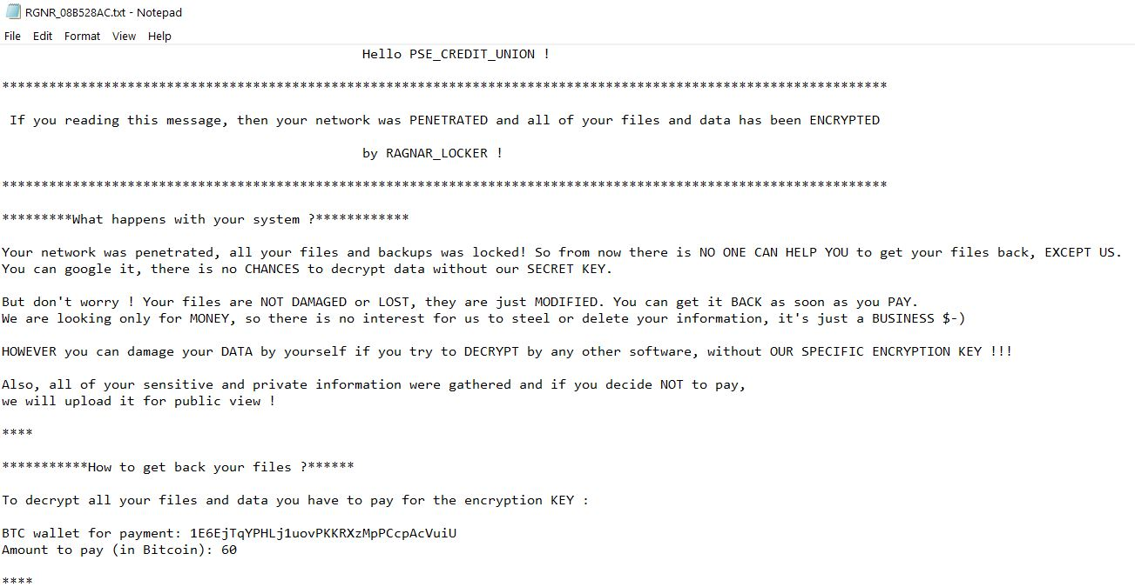
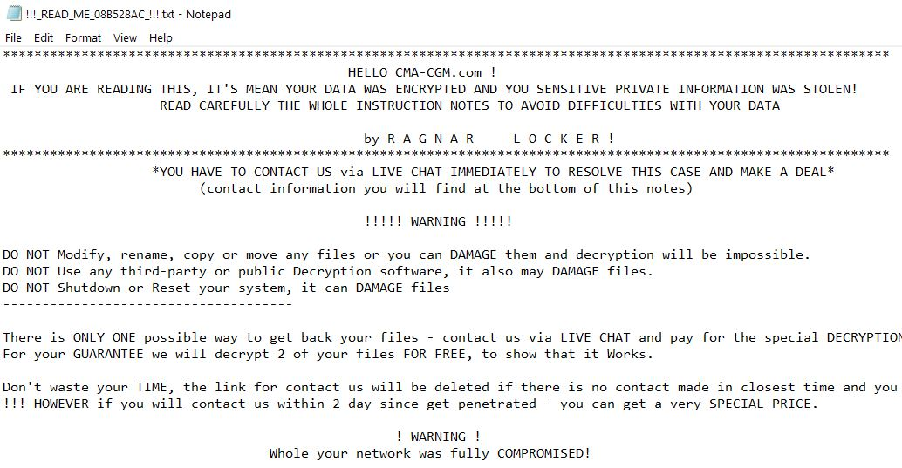
Key Result 3
Notes:
The evolution of the ransom note follows the overall trend observed in the assembly code.
The threat actors have excluded information about the decryption price and bitcoin wallet in strain 2.
This is likely done to improve operational security. Moreover, the victim is steered to the attacker's web page instead of a third-party application.
These changes add a veil of secrecy and protection, making it harder for researchers and law enforcement to track the threat actors based on the ransomware strain itself.

Slide 9
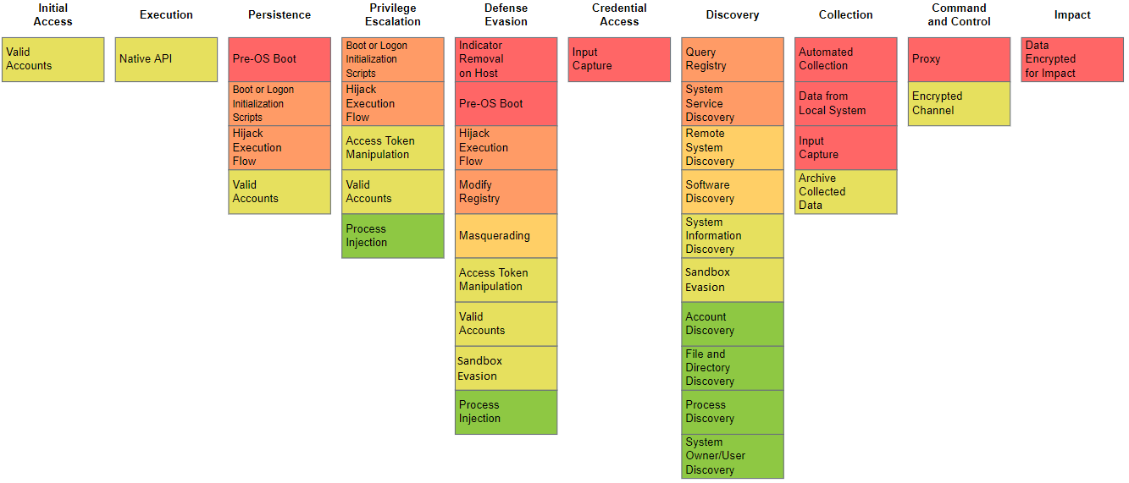
Key Results
Notes:
The displayed heatmap is a concatenation of all the techniques used, and is based on the MITRE ATT&Ck framework.
Most of the tactics and techniques used by the Ragnar Locker ransomware have remained constant from January to November 2020.
In fact, 72% of the techniques used apply to both strains.
Some of the variations are simply because the ransomware creators have tweaked how the ransomware performs the same actions.
This further confirms the observations from the analysis, stating that most of the code structure was the same in strain 1 and 2.

Slide 10
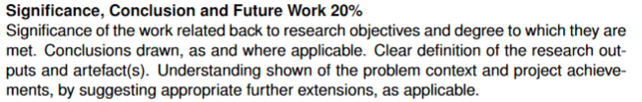
Conclusions
▪ Conclusion
▪ Significance
▪ Future work
Notes:
Based on the findings, one can infer that the Ragnar Locker group focuses their time and effort on developing their skills and approach to the initial stages of an attack rather than their already functional ransomware tool.
Such an approach is logical, as the threat actors can optimise both the victim environment and the ransomware as needed once they have established persistence on the network.
The research presented in this paper contributes to the common knowledge of how Ragnar Locker operates. Systematically analysing ransomware strains' key traits enables researchers to compare results, both within one family and against other species.
Such an approach will facilitate the construction of solid and effective prevention mechanisms.
Moreover, this research adds to the academic work focusing on cybercrime and ransomware. Few research papers discuss ransomware operations and analysis, especially human-operated ransomware attacks. This is a contrast to the threat such attacks pose to society.
Future work should investigate developing a comparison module utilising fuzzy hashing to develop the Hybridised Malware framework further.
By incorporating an automated fuzzy hashing module one can compare strains to each other at the code level and uncover similarities and relations more accurately.
Ragnar Locker is a human operated ransomware, thus attacks carried out by this actor is fundamentally different from the strains previously analysed with the Hybridised Malware framework. To gain a broader understanding of how contemporary strains are built, another possibility for future work is to analyse other ransomware families used in big game hunting.
This concludes this brief and executive presentation of my project.
I am happy to take questions.

Slide 11
References
Al-rimy, B. A. S., Maarof, M. A., & Shaid, S. Z. M. (2018). Ransomware threat success factors, taxonomy, and countermeasures: A survey and research directions. In Computers and Security (Vol. 74, pp. 144–166). Elsevier Ltd. https://doi.org/10.1016/j.cose.2018.01.001
Ali, M., Shiaeles, S., Clarke, N., & Kontogeorgis, D. (2019). A proactive malicious software identification approach for digital forensic examiners. Journal of Information Security and Applications, 47, 139–155. https://doi.org/10.1016/j.jisa.2019.04.013
Chen, Q., & Bridges, R. A. (2017). Automated behavioral analysis of malware: A case study of wannacry ransomware. Proceedings - 16th IEEE International Conference on Machine Learning and Applications, ICMLA 2017, 2017-Decem, 454–460. https://doi.org/10.1109/ICMLA.2017.0-119
Davies, S. R., Macfarlane, R., & Buchanan, W. J. (2020). Evaluation of live forensic techniques in ransomware attack mitigation. Forensic Science International: Digital Investigation, 33. https://doi.org/10.1016/j.fsidi.2020.300979
Schmitt, V. (2019). A comparative study of CERBER, MAKTUB and LOCKY [Rohdes University]. http://hdl.handle.net/10962/92313

